Slide 1
AP & GP
(ASSIGNMENT :-2)

Slide 2
AP AND GP(ASSIGNMENT :-2)
Q 1. Find the 5th term of the G. P.: 1/7,1/14, 1/28 ...
1/108
B. 1/112
C. 1/128
D. 2/115

Slide 3
AP AND GP(ASSIGNMENT :-2)
Q 1. Find the 5th term of the G. P.: 1/7,1/14, 1/28 ...
1/108
B. 1/112
C. 1/128
D. 2/115

Slide 4
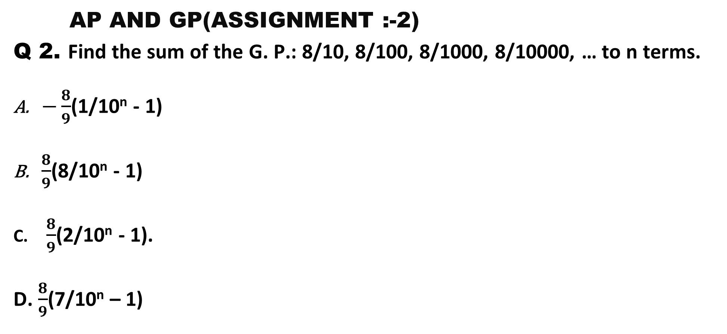
AP AND GP(ASSIGNMENT :-2)
Q 2. Find the sum of the G. P.: 8/10, 8/100, 8/1000, 8/10000, … to n terms.
$−\frac{8}{9}$(1/10^{n} - 1)
$\frac{8}{9}$(8/10^{n} - 1)
$\frac{8}{9}$(2/10^{n} - 1).
D. $\frac{8}{9}$(7/10^{n} – 1)

Slide 5
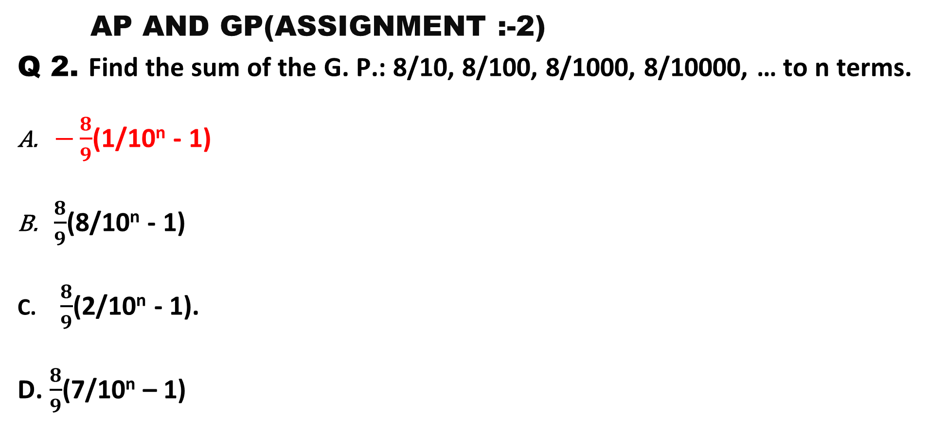
AP AND GP(ASSIGNMENT :-2)
Q 2. Find the sum of the G. P.: 8/10, 8/100, 8/1000, 8/10000, … to n terms.
$−\frac{8}{9}$(1/10^{n} - 1)
$\frac{8}{9}$(8/10^{n} - 1)
$\frac{8}{9}$(2/10^{n} - 1).
D. $\frac{8}{9}$(7/10^{n} – 1)

Slide 6

AP AND GP(ASSIGNMENT :-2)
Q 3. Find the sum of the following infinite G. P $\frac{1}{3}, −\frac{2}{9},\frac{4}{27}, −\frac{8}{81},$………
1/2
B. 1
C. 1/3
D. 1/5

Slide 7
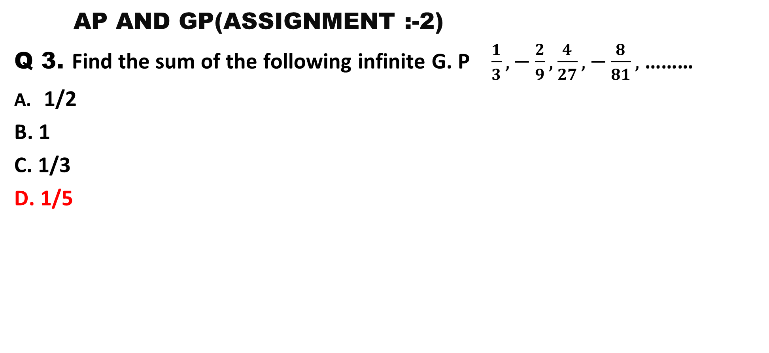
AP AND GP(ASSIGNMENT :-2)
Q 3. Find the sum of the following infinite G. P $\frac{1}{3}, −\frac{2}{9},\frac{4}{27}, −\frac{8}{81},$………
1/2
B. 1
C. 1/3
D. 1/5

Slide 8

AP AND GP(ASSIGNMENT :-2)
Q 4. The distance travelled (in m) by a ball dropped from a height are 128/9, 32/3, 8, 6... How much distance will it travel before coming to rest ?
$\frac{464}{9}$m
B. 120cm
C. $\frac{512}{9}$m
D. $\frac{256}{9}$m

Slide 9
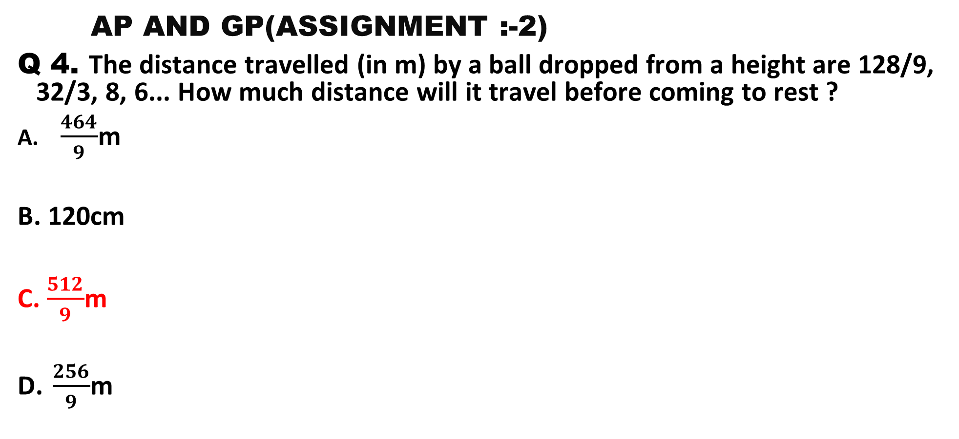
AP AND GP(ASSIGNMENT :-2)
Q 4. The distance travelled (in m) by a ball dropped from a height are 128/9, 32/3, 8, 6... How much distance will it travel before coming to rest ?
$\frac{464}{9}$m
B. 120cm
C. $\frac{512}{9}$m
D. $\frac{256}{9}$m

Slide 10
AP AND GP(ASSIGNMENT :-2)
Q 5. Insert three geometric means between 2 and 81/8.
3, 9/2, - 27/4
B. - 3, 9/2, 27/4
C. 3, 9/2, 27/4
D. 3, 9/2, 27/8

Slide 11
AP AND GP(ASSIGNMENT :-2)
Q 5. Insert three geometric means between 2 and 81/8.
3, 9/2, - 27/4
B. - 3, 9/2, 27/4
C. 3, 9/2, 27/4
D. 3, 9/2, 27/8

Slide 12
AP AND GP(ASSIGNMENT :-2)
Q 6. The arithmetic mean between two numbers is 75 and their geometric mean is 21. Find the numbers.
133 and 17
B. 63 and 87
C. 3 and 147
D. 73 and 77

Slide 13
AP AND GP(ASSIGNMENT :-2)
Q 6. The arithmetic mean between two numbers is 75 and their geometric mean is 21. Find the numbers.
133 and 17
B. 63 and 87
C. 3 and 147
D. 73 and 77

Slide 14
AP AND GP(ASSIGNMENT :-2)
Q 7. The product of first three terms of a G. P. is 512. If we add 2 to its second term, the three terms form an A. P. Find the terms of the G. P.
4, 8, 16
B. 16, 8, 4
C. 12, 24, 48
D. Option A or B

Slide 15
AP AND GP(ASSIGNMENT :-2)
Q 7. The product of first three terms of a G. P. is 512. If we add 2 to its second term, the three terms form an A. P. Find the terms of the G. P.
4, 8, 16
B. 16, 8, 4
C. 12, 24, 48
D. Option A or B

Slide 16
AP AND GP(ASSIGNMENT :-2)
Q 8. The sum of an infinite G. P. with positive terms is 48 and sum of its first two terms is 36. Find the second term.
10
B. 18
C. 12
D. 20

Slide 17
AP AND GP(ASSIGNMENT :-2)
Q 8. The sum of an infinite G. P. with positive terms is 48 and sum of its first two terms is 36. Find the second term.
10
B. 18
C. 12
D. 20

Slide 18
AP AND GP(ASSIGNMENT :-2)
Q 9. In the series 2, 6, 18, 54, ...... what will be the 8th term ?
A.4370
B. 4374
C. 7443
D.7434

Slide 19
AP AND GP(ASSIGNMENT :-2)
Q 9. In the series 2, 6, 18, 54, ...... what will be the 8th term ?
A.4370
B. 4374
C. 7443
D.7434

Slide 20
AP AND GP(ASSIGNMENT :-2)
Q 10. Find the number of terms in the geometric progression 6, 12, 24, ..., 1536
10
B. 9
C. 22
D. 20

Slide 21
AP AND GP(ASSIGNMENT :-2)
Q 10. Find the number of terms in the geometric progression 6, 12, 24, ..., 1536
10
B. 9
C. 22
D. 20

Slide 22
AP AND GP(ASSIGNMENT :-2)
Q 11. Determine the common ratio r of a geometric progression with first term is 5 and forth term is -40.
1
B. - 2
C. 2
D. 10

Slide 23
AP AND GP(ASSIGNMENT :-2)
Q 11. Determine the common ratio r of a geometric progression with first term is 5 and forth term is -40.
1
B. - 2
C. 2
D. 10

Slide 24
AP AND GP(ASSIGNMENT :-2)
Q 12. Let a_{n} be an increasing geometric progression. If the first term a₁ =2 and the fifth term a₅=162 , determine a₃
A. 5
B. -8
C. 18
D. 10

Slide 25
AP AND GP(ASSIGNMENT :-2)
Q 12. Let a_{n} be an increasing geometric progression. If the first term a₁ =2 and the fifth term a₅=162 , determine a₃
A. 5
B. -8
C. 18
D. 10

Slide 26
AP AND GP(ASSIGNMENT :-2)
Q 13. Let a_{n} be a geometric progression, such that a1=2 and r=3. Find the sum of the first five elements.
547
B. -82
C. 242
D. 100

Slide 27
AP AND GP(ASSIGNMENT :-2)
Q 13. Let a_{n} be a geometric progression, such that a1=2 and r=3. Find the sum of the first five elements.
547
B. -82
C. 242
D. 100

Slide 28
AP AND GP(ASSIGNMENT :-2)
Q 14. Let a_{n} be a geometric progression defined as a₁ =1 and r=5. Find the sum a₁ + a₂ +a₃+a₄ +a₅
855
B. 554
C. 285
D. 781

Slide 29
AP AND GP(ASSIGNMENT :-2)
Q 14. Let a_{n} be a geometric progression defined as a₁ =1 and r=5. Find the sum a₁ + a₂ +a₃+a₄ +a₅
855
B. 554
C. 285
D. 781

Slide 30
THANK YOU

